Slide 1
Rise of the Hackers– Nov 06
Agenda
NOVA Video
https://www.youtube.com/watch?v=-ZdasoAGMQs
Upcoming
Tomorrow: Computer Virus Case Study

Slide 2
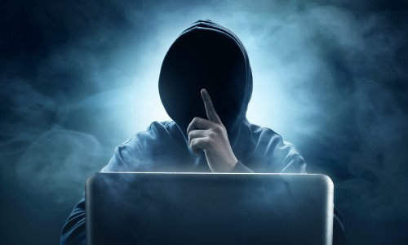
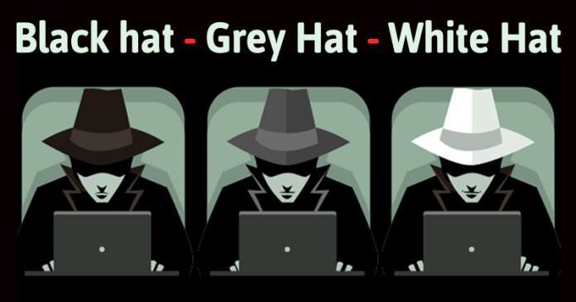
What is a Hacker
Evil?
or Good?

Slide 3
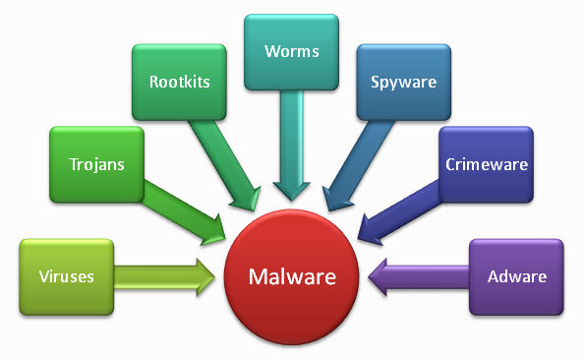
What is a Computer Virus?
PHISH (email, click-bate)
Worm
Trojan
Ransomware

